Slide 1
Security in Computing, Fifth Edition
Chapter 11: Legal Issues and Ethics

Slide 2
Chapter 11 Objectives
Learn about copyrights, patents, and trade secrets and their roles in software protection
Describe how information is different from other assets
Examine relationships between employees and employers in the context of software development
Understand vendor responsibilities and responsible vulnerability disclosure
Learn about a variety of computer security–relevant legal statutes
Explore ethics in a computer security and privacy context

Slide 3
Protecting Programs and Data
Copyrights
Designed to protect the expression of ideas
Gives the author the exclusive right to make copies of the expression and sell them to the public
Patents
Designed to protect inventions, tangible objects, or ways to make them
Patents were intended to apply to the results of science, technology, and engineering as opposed to arts and writing
Trade secrets
Information that gives one company a competitive advantage over others
Must be closely guarded as a secret, or legal protections are lost
Notes:
We go into more depth on these bullets in the following slides

Slide 4
Copyrights
In the United States, copyright can be registered for original works of expression but not for ideas
“Fair use” allows copyrighted material to be used in ways that do not interfere with the author’s rights: criticism, comment, new reporting, teaching, scholarship, or research
Software can be copyrighted
The code is protected but the algorithms are not
If source code is not published (i.e., only compiled code is published), copyright may not apply

Slide 5
Patents
Novelty requirement
Cannot be obvious to a person ordinarily skilled in the relevant field
Must convince the patent office that the invention deserves a patent (i.e., that it is novel)
A patent holder must oppose all infringement or risk losing the patent rights
Since 1981, patent law has extended to include computer software, recognizing that algorithms are inventions

Slide 6
Trade Secrets
If someone obtains a trade secret improperly and profits from it, the owner can recover profits, damages, lost revenues, and legal costs
If someone else happens to discover the secret independently, there is no infringement
Reverse engineering a trade secret is not infringement
Trade secrets can protect secret computer algorithms from being used in other products
Cannot provide legal protection against software piracy
The challenge of using trade secrets to protect software is that software can be effectively reverse engineered

Slide 7
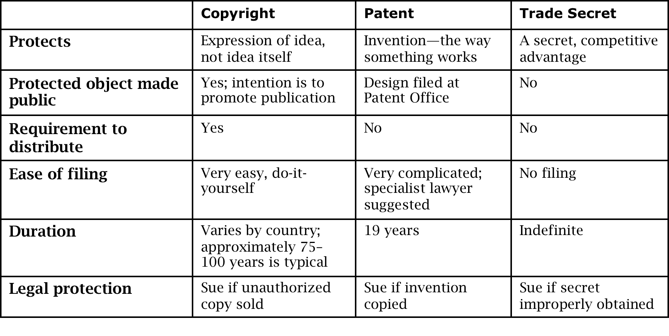
Comparing Copyrights, Patents, and Trade Secrets

Slide 8
Special Characteristics of Information
Like material goods, information is valuable
Unlike material goods, information
Is not depletable
Can be replicated
Has a minimal marginal cost
Often has a time-dependent value
Often transferred intangibly
All of these factors impact how information is treated under the law
Notes:
These differences beg a philosophical question: Is “theft” an appropriate paradigm in the context of information?

Slide 9
Rights of Employees and Employers
Ownership of a patent
An employer has the right to patent if the employee’s job functions included inventing the product. Even if an employee patents something, the employer can argue for a right to use the invention if the employer contributed some resources
Ownership of a copyright
Similar to patent
Licenses
In return for a fee, a programmer grants a company a license to use her program. The license can include many factors, such as time period, number of users, number of systems, and so on
Trade secret protection
A company owns the trade secrets of its business-confidential data. As with copyrights and patents, an employer can argue about having contributed to the development of trade secrets

Slide 10
Reporting Software Flaws
A proposed model for responsible vulnerability reporting:
The vendor must acknowledge a vulnerability report confidentially to the reporter.
The vendor must agree that the vulnerability exists (or argue otherwise) confidentially to the reporter.
The vendor must inform users of the vulnerability and any available countermeasures within 30 days or request additional time from the reporter as needed.
After informing users, the vendor may request from the reporter a 30-day quiet period to allow users time to install patches.
At the end of the quiet period, the vendor and reporter should agree on a date at which time the vulnerability information may be released to the general public.
The vendor should credit the reporter with having located the vulnerability.
If the vendor does not follow these steps, the reporter should work with a coordinator to determine a responsible way to publicize the vulnerability.
Notes:
This model, as well as others like it, was created in response to a series of incidents in which some vendors refused to patch disclosed vulnerabilities in reasonable time. Some software vendors still threaten vulnerability researchers with lawsuits, while others happily pay bounties for disclosure of vulnerabilities in their software.

Slide 11
Computer Crime
Rules of property
Most laws have evolved to recognize data and computer services as property.
Rules of evidence
Demonstrating authenticity of computer-based evidence is a challenge.
Chain of custody: Law enforcement track clearly and completely the order and identity of people who had access to evidence in an effort to demonstrate that no one had the opportunity to tamper.
Threats to integrity and confidentiality
Laws have evolved to recognize breaches of privacy and damage to data as crimes.
Value of data
Digital data, from a legal perspective, is now considered to be worth what a buyer would be willing to pay for it.

Slide 12
Computer Crime Is Hard to Prosecute
Lack of domain understanding by courts, lawyers, law enforcement, and jurors
Lack of physical evidence
Lack of political impact because direct harm to people is harder to identify
Complexity of cases
Ages of defendants, who are more likely than many other serious criminals to be juvenile
Even when there is clear evidence of a crime, the victim (e.g., banks) may not wish to prosecute because they may lose the trust of their customers

Slide 13
Example Computer Statutes
US Computer Fraud and Abuse Act
Prohibits computer fraud, trafficking in passwords, transmitting code that damages a system, unauthorized access to systems
US Economic Espionage Act
Outlaws use of a computer for foreign espionage
US Freedom of Information Act
Provides public access to information collective by the executive branch of the US government
US Privacy Act
Protects privacy of personal data collected by the government

Slide 14
Example Computer Statutes (cont.)
US Electronic Communications Privacy Act
Protects against electronic wiretapping
Gramm-Leach-Bliley Act
Requires financial institutions to undergo security risk assessments, adopt a program to protect customers’ nonpublic personal information, and provide customers with privacy policies
HIPAA
Requires protection of the privacy of individuals’ medical records
USA Patriot Act
Gave law enforcement an easier path to obtaining wiretaps on potential foreign agents and made damaging computer systems a felony

Slide 15
Example Computer Statutes (cont.)
The CAN SPAM Act
Bans deceptive email advertising, requires opt-out options
California Breach Notification
Requires any company doing business in California to notify individuals of any breach that is reasonably believed to have compromised personal information of a California resident
Council of Europe Agreement on Cybercrime
Requires signing countries to define cybercrime activities and support their investigation and prosecution across national boundaries
EU Data Protection Act
Established privacy rights and protection responsibilities for all citizens of member countries

Slide 16
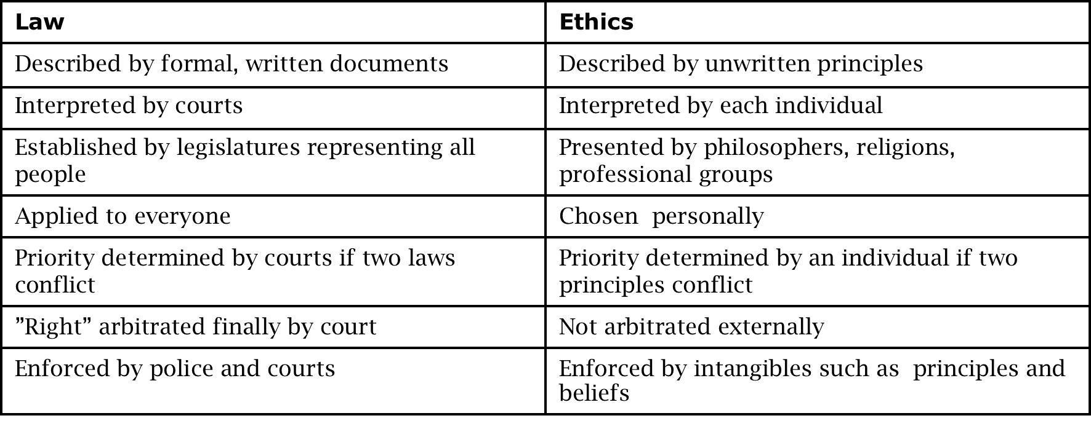
Comparison of Law and Ethics
Notes:
This slide begins the ethics section of the chapter. We provide a very basic introduction to ethics, and then present ethical situations for the class to discuss.

Slide 17
Examining a Situation for Ethical Issues
Understand the situation
Know several theories of ethical reasoning
List the ethical principles involved
Determine which principles outweigh others
Make and defend an ethical choice

Slide 18
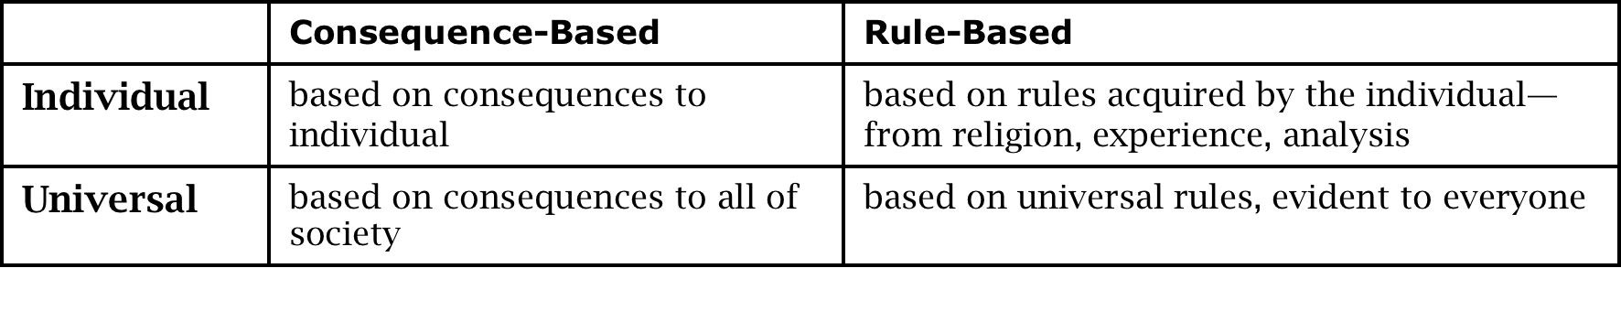
Bases of Ethical Theories
Notes:
This is the most basic taxonomy of ethical theories.
The teleological theory of ethics focuses on the consequences of an action. The action to be chosen is the one that results in the greatest future good and the least harm. For example, if a fellow student asks you to write a program he was assigned for a class, you might consider the good (he will owe you a favor) against the bad (you might get caught, causing embarrassment and possible disciplinary action, plus your friend will not learn the techniques to be gained from writing the program, leaving him deficient).
Rule-deontology is the school of ethical reasoning that believes certain universal, self-evident, natural rules specify our proper conduct. Certain basic moral principles are adhered to because of our responsibilities to one another; these principles are often stated as rights: the right to know, the right to privacy, the right to fair compensation for work.

Slide 19
Situation I: Use of Computer Services
Dave works as a programmer for a large software company. He writes and tests utility programs such as compilers. His company operates two computing shifts: During the day, program development and online applications are run; at night, batch production jobs are completed. Dave has access to workload data and learns that the evening batch runs are complementary to daytime programming tasks; that is, adding programming work during the night shift would not adversely affect performance of the computer to other users.
Dave comes back after normal hours to develop a program to manage his own stock portfolio. His drain on the system is minimal, and he uses very few expendable supplies, such as printer paper. Is Dave’s behavior ethical?
Notes:
Analysis:
The utilitarian would consider the total excess of good over bad for all people. Dave receives benefit from use of computer time, although for this application the amount of time is not large. Dave has a possibility of punishment, but he may rate that as unlikely. The company is neither harmed nor helped by this activity. Thus, the utilitarian could argue that Dave’s use is justifiable.
The universalism principle seems as if it would cause a problem because, clearly, if everyone did this, quality of service would degrade. A utilitarian would say that each new user has to weigh good and bad separately. Dave’s use might not burden the system, and neither might Ann’s; but when Bill wants to use the system, it is heavily enough used that Bill’s use would affect other people.

Slide 20
Situation II: Privacy Rights
Donald works for the county records department as a computer records clerk, where he has access to files of property tax records. For a scientific study, a researcher, Ethel, has been granted access to the numerical portion—but not the corresponding names—of some records.
Ethel finds some information that she would like to use, but she needs the names and addresses corresponding with certain properties. Ethel asks Donald to retrieve the names and addresses so she can contact these people for more information and for permission to do further study.
Should Donald release the names and addresses?
Notes:
Analysis:
A rule-deontologist would argue that privacy is an inherent good and that one should not violate the privacy of another. Therefore, Donald should not release the names.

Slide 21
Situation III: Denial of Service
Charlie and Carol are students at a university in a computer science program. Each writes a program for a class assignment. Charlie’s program happens to uncover a flaw in a compiler that ultimately causes the entire computing system to fail; all users lose the results of their current computation. Charlie’s program uses acceptable features of the language; the compiler is at fault. Charlie did not suspect his program would cause a system failure. He reports the program to the computing center and tries to find ways to achieve his intended result without exercising the system flaw.
The system continues to fail periodically, for a total of 10 times (beyond the first failure). When the system fails, sometimes Charlie is running a program, but sometimes Charlie is not. The director contacts Charlie, who shows all his program versions to the computing center staff. The staff concludes that Charlie may have been inadvertently responsible for some, but not all, of the system failures, but that his latest approach to solving the assigned problem is unlikely to lead to additional system failures.
On further analysis, the computing center director notes that Carol has had programs running each of the first eight (of 10) times the system failed. The director uses administrative privilege to inspect Carol’s files and finds a file that exploits the same vulnerability as did Charlie’s program. The director immediately suspends Carol’s account, denying Carol access to the computing system. Because of this, Carol is unable to complete her assignment on time; she receives a D in the course, and she drops out of school.
Notes:
Analysis:
In this situation the choices are intentionally not obvious. The situation is presented as a completed scenario, but in studying it you are being asked to suggest alternative actions the players could have taken. In this way, you build a repertoire of actions that you can consider in similar situations that might arise.

Slide 22
Situation IV: Ownership of Programs
Greg is a programmer working for a large aerospace firm, Star Computers, which works on many government contracts; Cathy is Greg’s supervisor. Greg is assigned to program various kinds of simulations.
To improve his programming abilities, Greg writes some programming tools, such as a cross-reference facility and a program that automatically extracts documentation from source code. These are not assigned tasks for Greg; he writes them independently and uses them at work, but he does not tell anyone about them. Greg has written them in the evenings, at home, on his personal computer.
Greg decides to market these programming aids by himself. When Star’s management hears of this, Cathy is instructed to tell Greg that he has no right to market these products since, when he was employed, he signed a form stating that all inventions become the property of the company. Cathy does not agree with this position because she knows that Greg has done this work on his own. She reluctantly tells Greg that he cannot market these products. She also asks Greg for a copy of the products.
Cathy quits working for Star and takes a supervisory position with Purple Computers, a competitor of Star. She takes with her a copy of Greg’s products and distributes it to the people who work with her. These products are so successful that they substantially improve the effectiveness of her employees, and Cathy is praised by her management and receives a healthy bonus. Greg hears of this, and contacts Cathy, who contends that because the product was determined to belong to Star and because Star worked largely on government funding, the products were really in the public domain and therefore they belonged to no one in particular.
Notes:
Analysis:
This story certainly has major legal implications. Virtually everyone could sue everyone else and, depending on the amount they are willing to spend on legal expenses, they could keep the cases in the courts for several years. Probably no judgment would satisfy all.
Let us set aside the legal aspects and look at the ethical issues. We want to determine who might have done what, and what changes might have been possible to prevent a tangle for the courts to unscramble.
Let us explore the principles involved:
Rights. What are the respective rights of Greg, Cathy, Star, and Purple?
Basis. What gives Greg, Cathy, Star, and Purple those rights? What principles of fair play, business, property rights, and so forth are involved in this case?
Priority. Which of these principles are inferior to which others? Which ones take precedence? (Note that it may be impossible to compare two different rights, so the outcome of this analysis may yield some rights that are important but that cannot be ranked first, second, third.)
Additional information. What additional facts do you need in order to analyze this case? What assumptions are you making in performing the analysis?

Slide 23
Situation V: Proprietary Resources
Suzie owns a copy of G-Whiz, a proprietary software package she purchased legitimately. The software is copyrighted, and the documentation contains a license agreement that says that the software is for use by the purchaser only. Suzie invites Luis to look at the software to see if it will fit his needs. Luis goes to Suzie’s computer and she demonstrates the software to him. He says he likes what he sees, but he would like to try it in a longer test.
Notes:
Extensions to the Case:
So far, the actions have all been ethically sound. The next steps are where ethical responsibilities arise. Take each of the following steps as independent; that is, do not assume that any of the other steps has occurred in your analysis of one step.
Suzie offers to copy the disk for Luis to use.
Suzie copies the disk for Luis to use, and Luis uses it for some period of time.
Suzie copies the disk for Luis to use; Luis uses it for some period of time and then buys a copy for himself.
Suzie copies the disk for Luis to try out overnight, under the restriction that he must bring the disk back to her tomorrow and must not copy it for himself. Luis does so.
Suzie copies the disk with the same restrictions, but Luis makes a copy for himself before returning it to Suzie.
Suzie copies the disk with the same restrictions, and Luis makes a copy for himself, but he then purchases a copy.
Suzie copies the disk with the same restrictions, but Luis does not return it.
For each of these extensions, describe who is affected, which ethical issues are involved, and which principles override which others.

Slide 24
Situation VI: Fraud
Alicia works as a programmer in a corporation. Ed, her supervisor, tells her to write a program to allow people to post entries directly to the company’s accounting files (“the books”). Alicia knows that ordinarily programs that affect the books involve several steps, all of which have to balance. Alicia realizes that with the new program, it will be possible for one person to make changes to crucial amounts, and there will be no way to trace who made these changes, with what justification, or when.
Alicia raises these concerns to Ed, who tells her not to be concerned, that her job is simply to write the programs as he specifies. He says that he is aware of the potential misuse of these programs, but he justifies his request by noting that periodically a figure is mistakenly entered in the books and the company needs a way to correct the inaccurate figure.
Notes:
Analysis:
The act-deontologist would say that truth is good. Therefore, if Alicia thought the purpose of the program was to deceive, writing it would not be a good act. (If the purpose were for learning or to be able to admire beautiful code, then writing it might be justifiable.)
A more useful analysis is from the perspective of the utilitarian. To Alicia, writing the program brings possible harm for being an accomplice to fraud, with the gain of having cooperated with her manager. She has a possible item with which to blackmail Ed, but Ed might also turn on her and say the program was her idea. On balance, this option seems to have a strong negative slant.
By not writing the program, her possible harm is being fired. However, she has a potential gain by being able to “blow the whistle” on Ed. This option does not seem to bring her much good, either. But fraudulent acts have negative consequences for the stockholders, the banks, and other innocent employees. Not writing the program brings only personal harm to Alicia, which is similar to the harm described earlier. Thus, it seems as if not writing the program is the more positive option.
There is another possibility. The program may not be for fraudulent purposes. If so, then there is no ethical conflict. Therefore, Alicia might try to determine whether Ed’s motives are fraudulent.

Slide 25
Situation VII: Accuracy of Information
Emma is a researcher at an institute where Paul is a statistical programmer. Emma wrote a grant request to a cereal manufacturer to show the nutritional value of a new cereal, Raw Bits. The manufacturer funded Emma’s study. Emma is not a statistician. She has brought all of her data to Paul to ask him to perform appropriate analyses and to print reports for her to send to the manufacturer. Unfortunately, the data Emma has collected seem to refute the claim that Raw Bits is nutritious, and, in fact, they may indicate that Raw Bits is harmful.
Paul presents his analyses to Emma but also indicates that some other correlations could be performed that would cast Raw Bits in a more favorable light. Paul makes a facetious remark about his being able to use statistics to support either side of any issue.
Notes:
Analysis:
Clearly, if Paul changed data values in this study, he would be acting unethically. But is it any more ethical for him to suggest analyzing correct data in a way that supports two or more different conclusions? Is Paul obligated to present both the positive and the negative analyses? Is Paul responsible for the use to which others put his program results?
If Emma does not understand statistical analysis, is she acting ethically in accepting Paul’s positive conclusions? His negative conclusions? Emma suspects that if she forwards negative results to the manufacturer, they will just find another researcher to do another study. She suspects that if she forwards both sets of results to the manufacturer, they will publicize only the positive ones. What ethical principles support her sending both sets of data? What principles support her sending just the positive set? What other courses of action has she?

Slide 26
Situation VIII: Ethics of Hacking or Cracking
Goli is a computer security consultant; she enjoys the challenge of finding and fixing security vulnerabilities. Independently wealthy, she does not need to work, so she has ample spare time in which to test the security of systems.
In her spare time, Goli does three things: First, she aggressively attacks commercial products for vulnerabilities. She is quite proud of the tools and approach she has developed, and she is quite successful at finding flaws. Second, she probes accessible systems on the Internet, and when she finds vulnerable sites, she contacts the owners to offer her services repairing the problems. Finally, she is a strong believer in high-quality pastry, and she plants small programs to slow performance in the websites of pastry shops that do not use enough butter in their pastries. Let us examine these three actions in order.
Notes:
Analysis:
Vulnerabilities in Commercial Products
We have already described a current debate regarding the vulnerability reporting process. Now let us explore the ethical issues involved in that debate.
Clearly, from a rule-based ethical theory, attackers are wrong to perform malicious attacks. The appropriate theory seems to be one of consequence: Who is helped or hurt by finding and publicizing flaws in products? Relevant parties are attackers, the vulnerability finder, the vendor, and the using public. Notoriety or credit for finding the flaw is a small interest. And the interests of the vendor (financial, public relations) are less important than the interests of users to have secure products. But how are the interests of users best served?
Full disclosure helps users assess the seriousness of the vulnerability and apply appropriate protection. But it also gives attackers more information with which to formulate attacks. Early full disclosure—before the vendor has countermeasures ready—may actually harm users by leaving them vulnerable to a now widely known attack.
Partial disclosure—the general nature of the vulnerability but not a detailed exploitation scenario—may forestall attackers. One can argue that the vulnerability details are there to be discovered; when a vendor announces a patch for an unspecified flaw in a product, the attackers will test that product aggressively and study the patch carefully to try to determine the vulnerability. Attackers will then spread a complete description of the vulnerability to other attackers through an underground network, and attacks will start against users who may not have applied the vendor’s fix.
No disclosure. Perhaps users are best served by a scheme in which every so often new code is released, sometimes fixing security vulnerabilities, sometimes fixing things that are not security related, and sometimes adding new features. But without a sense of significance or urgency, users may not install this new code.
Searching for Vulnerabilities and Customers
What are the ethical issues involved in searching for vulnerabilities? Again, the party of greatest interest is the user community and the good or harm that can come from the search.
On the positive side, searching may find vulnerabilities. Clearly, it would be wrong for Goli to report vulnerabilities that were not there simply to get work, and it would also be wrong to report some but not all vulnerabilities to be able to use the additional vulnerabilities as future leverage against the client.
But suppose Goli does a diligent search for vulnerabilities and reports them to the potential client. Is that not similar to a service station owner’s advising you that a headlight is not operating when you take your car in for gasoline? Not quite, you might say. The headlight flaw can be seen without any possible harm to your car; probing for vulnerabilities might cause your system to fail.
The ethical question seems to be which is greater: the potential for good or the potential for harm? And if the potential for good is stronger, how much stronger does it need to be to override the risk of harm?
This problem is also related to the common practice of ostensible nonmalicious probing for vulnerabilities: Hackers see if they can access your system without your permission, perhaps by guessing a password. Eugene Spafford [SPA98] points out that many crackers simply want to look around, without damaging anything. As discussed in Sidebar 11-3, Spafford compares this seemingly innocent activity with entry into your house when the door is unlocked. Even when done without malicious intent, cracking can be a serious offense; at its worst, it has caused millions of dollars in damage. Although crackers are prosecuted severely with harsh penalties, cracking continues to be an appealing crime, especially to juveniles.
Politically Inspired Attacks
Finally, consider Goli’s interfering with operation of websites whose actions she opposes. We have purposely phrased the issue in a situation that arouses perhaps only a few gourmands and pâtissiers. We can dismiss the interest of the butter fans as an insignificant minority on an insignificant issue. But you can certainly think of many other issues that have brought on wars. (See Dorothy Denning’s excellent article on cybercriminals [DEN99a] for real examples of politically motivated computer activity.)
The ethical issues abound in this scenario. Some people will see the (butter) issue as one of inherent good, but is butter use one of the fundamental good principles, such as honesty or fairness or not doing harm to others? Is there universal agreement that butter use is good? Probably there will be a division of the world into the butter advocates (x%), the unrestricted pastry advocates (y%), and those who do not take a position (z%). By how much does x have to exceed y for Goli’s actions to be acceptable? What if the value of z is large? Greatest good for the greatest number requires a balance among these three percentages and some measure of benefit or harm.
Is butter use so patently good that it justifies harm to those who disagree? Who is helped and who suffers? Is the world helped if only good, but more expensive, pastries are available, so poor people can no longer afford pastry? Suppose we could determine that 99.9 percent of people in the world agreed that butter use was a good thing. Would that preponderance justify overriding the interests of the other 0.1 percent?

Slide 27
Summary
Copyrights, patents, and trade secrets all have roles to play in providing legal protection for software
Important legal intricacies determine relationships among employees, employers, software vendors, and customers
Statutes in a variety of overlapping jurisdictions may determine what computer crimes are, how they are investigated, and how they may be enforced
Unlike legal issues, ethical issues have both personal and philosophical elements and therefore often lack clear answers

